Slide 1


Bias in Policing – Using Predictive Modelling to Demonstrate Bias in the Seattle Police Department
Noelle Ferrari

Slide 2
Seattle PD Under Scrutiny
SPD has been under increased scrutiny in the wake of 2020’s Black Lives Matter protests, particularly the Capitol Hill Occupied Protest
SPD is facing budget cuts and increased pressure for reform, including calls to abolish the police entirely
“Terry Stops” have been critiqued as contributing to over-policing in low-income communities and communities of color, providing legitimacy to racially biased systems, and perpetuating systemic injustice
Notes:
The Seattle Police Department is not new to controversy—they have been under federal investigation since 2012 due to alleged issues with excessive use of force. However, in the last year they have come under increased public scrutiny in the wake of 2020’s Black Lives Matter protests, particularly the Capitol Hill Occupied Protest. Due to this, SPD is facing budget cuts and increased pressure for reform, including calls to abolish the police entirely.
This is an issue that looms large in public discourse, and it can be easy to be swayed by emotional arguments. I think it’s clear that there are people throughout this city that have been harmed by police action (or by police inaction), but in order to affect true change, it is important to have a strong factual basis behind these accusations. As a starting point for thiscouncil, I have analyzed publicly available data of Terry Stops made by SPD officers, in hopes that it can begin to demonstrate whether over-policing and racial bias are in fact areas of concern that require deeper investigation.
Due to the subjective nature of reasonable suspicion Terry Stops have been critiqued as:
contributing to over-policing in low-income communities and communities of color,
providing legitimacy to racially biased systems,
and perpetuating systemic injustice

Slide 3
Terry Stops By the Numbers
Notes:
Our data spans Terry Stops made between March 2015 and July 2021.
There are a few really interesting things demonstrated by the data

Slide 4

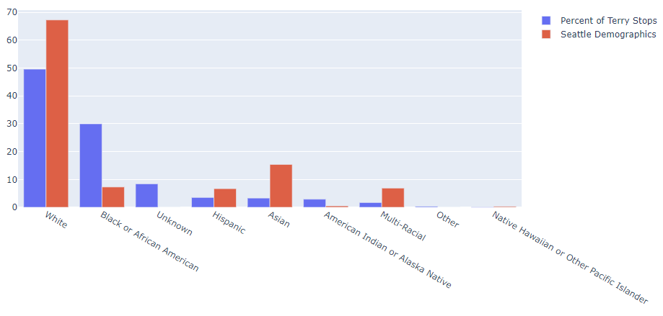
Racial Demographics
Notes:
It’s when we look at population demographics that we begin to see that accusations of racial injustice do have a basis in fact.
The blue bar on the left represents the population of Terry Stop Subjects, and the red bar on the right represents the population of the city of Seattle at large.
Despite making up 67% of the population, only 50% of Terry Stop subjects are white. In contrast, 30% of Terry Stop subjects are black, despite making up only 7% of the population.
Now, it’s important to note here that the race of a Terry Stop subject is reported as perceived by the officer

Slide 5
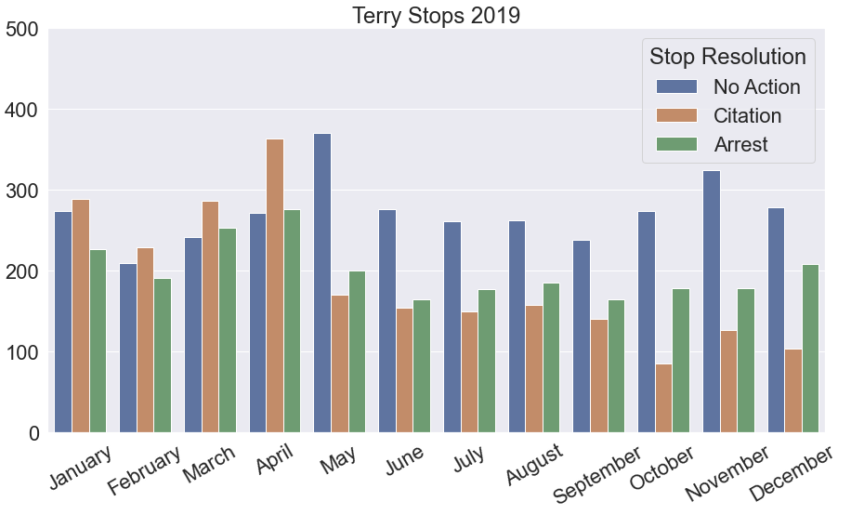
2019
Notes:
So the final thing I wanted to look at before modelling was the impact of the 2020 BLM protests on Terry Stops. If police officers know that people are watching them very closely, does that impact behavior?
So I want to look at the year 2019 first to establish a bit of a baseline—and we can actually see a bit of a shift in the proportion of stops that result in action in May 2019, though at this point I would need to do further research to determine what might be driving that.

Slide 6
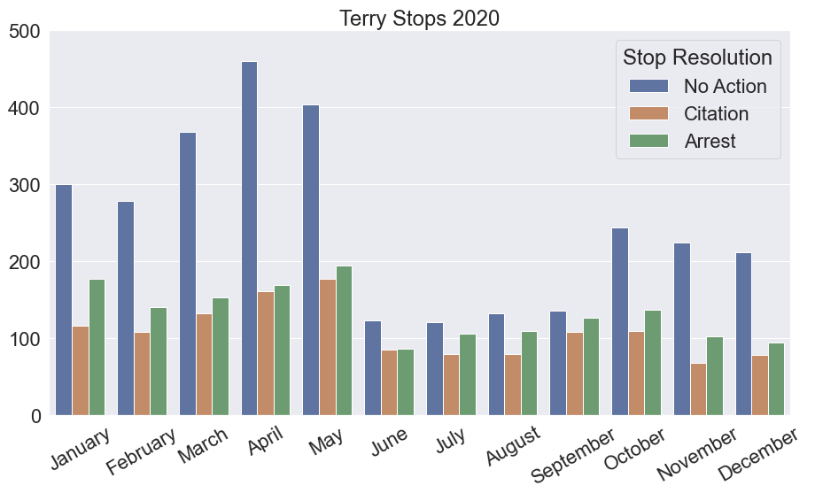
2020
Notes:
But what we see when we look at 2020 is first a large uptick in no action stops beginning in March, which correlates with the start of the COVID-19 pandemic and the strictest “shelter-in-place” orders, and then we do in fact see a major decline in June
BLM protests begin May 30
CHOP: June 8 – July 1

Slide 7
Predictive Modelling
Notes:
Predictive modelling can be a useful tool for exploring the ramifications of some of the trends we are seeing – since there is data available to us that officers may not have at the time they make a stop, such as whether or not the subject has a weapon, it would be difficult to use these models for prediction, so I have primarily used accuracy as a scoring metric.

Slide 8
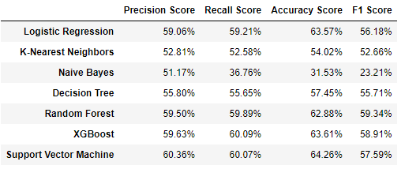
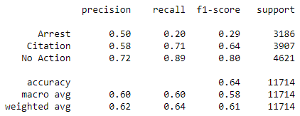
Initial Models
Notes:
I experimented with several different types of models to start with, but none of them performed amazingly well
These are the in-depth metrics for SVC, the best performing model, but all our models similarly struggled with making the distinction between Arrests and Citations

Slide 9
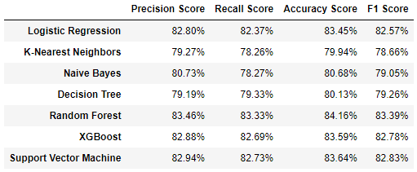
Initial Models
Notes:
I grouped citations and arrests together and condensed it to a binary classification problem: did this stop result in further police action? And these models performed much better.

Slide 10
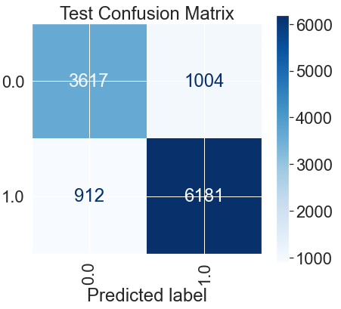
Using an XGBoost Model, we can predict whether a stop resulted in further action with 84% accuracy
Notes:
With some tuning of parameters, I developed a model that can predict whether a stop resulted in further police action with 84% accuracy

Slide 11
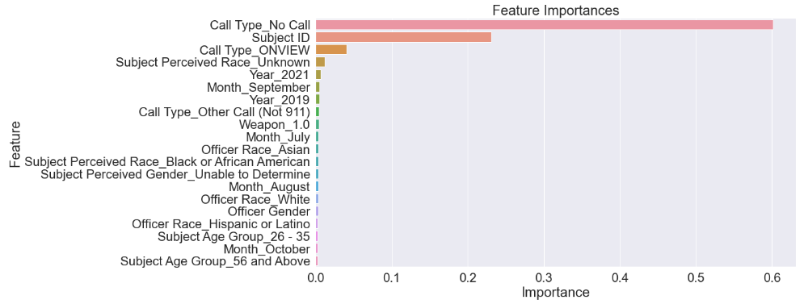
Feature Importances
Notes:
Overwhelmingly, the feature that is most important to our model is Call Type, followed by Subject ID, which indicates whether or not the subject provided identification when asked by the officer. Other features only provide small weight to the model

Slide 12
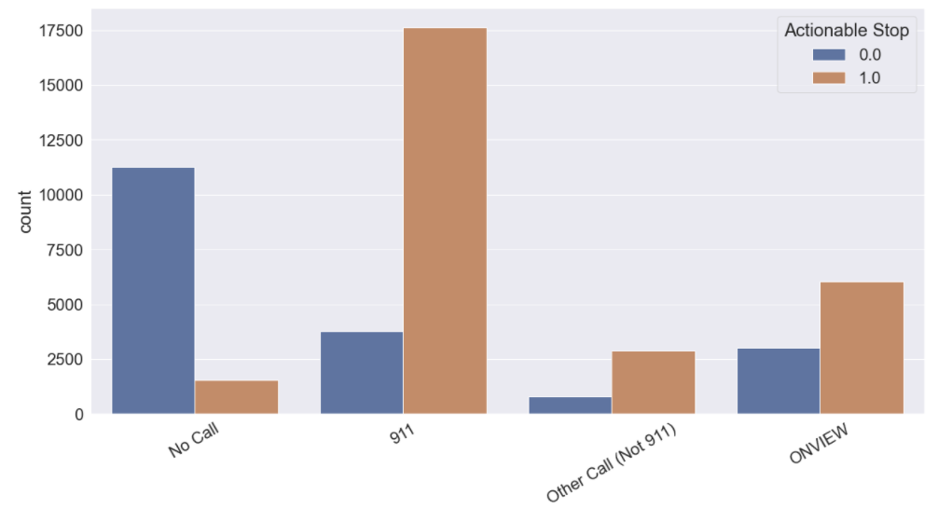

Slide 13
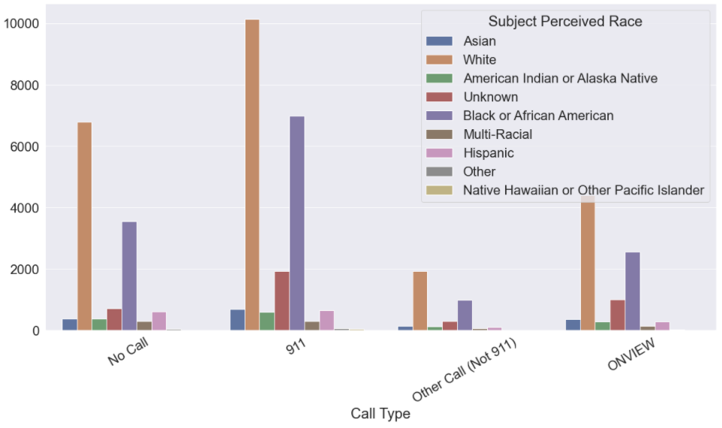

Slide 14
Conclusions and Next Steps
Some racial bias is evident in the data
Stops made without an associated 911 call are much less likely to result in police action and should be reduced.
Large scale data collection issues make some conclusions difficult to draw
Additional data about arrest outcomes would add depth to analysis

